Slide 1
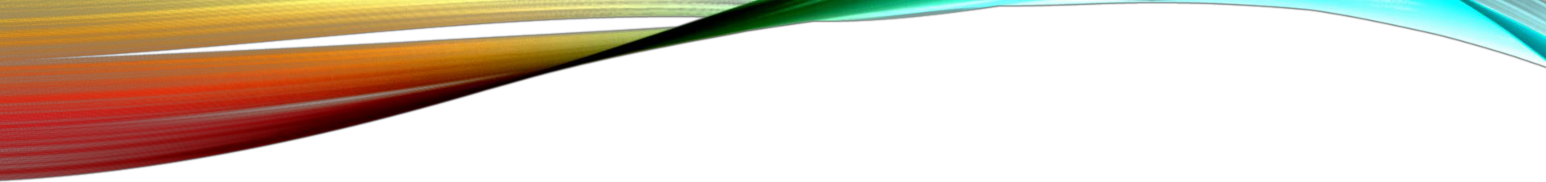
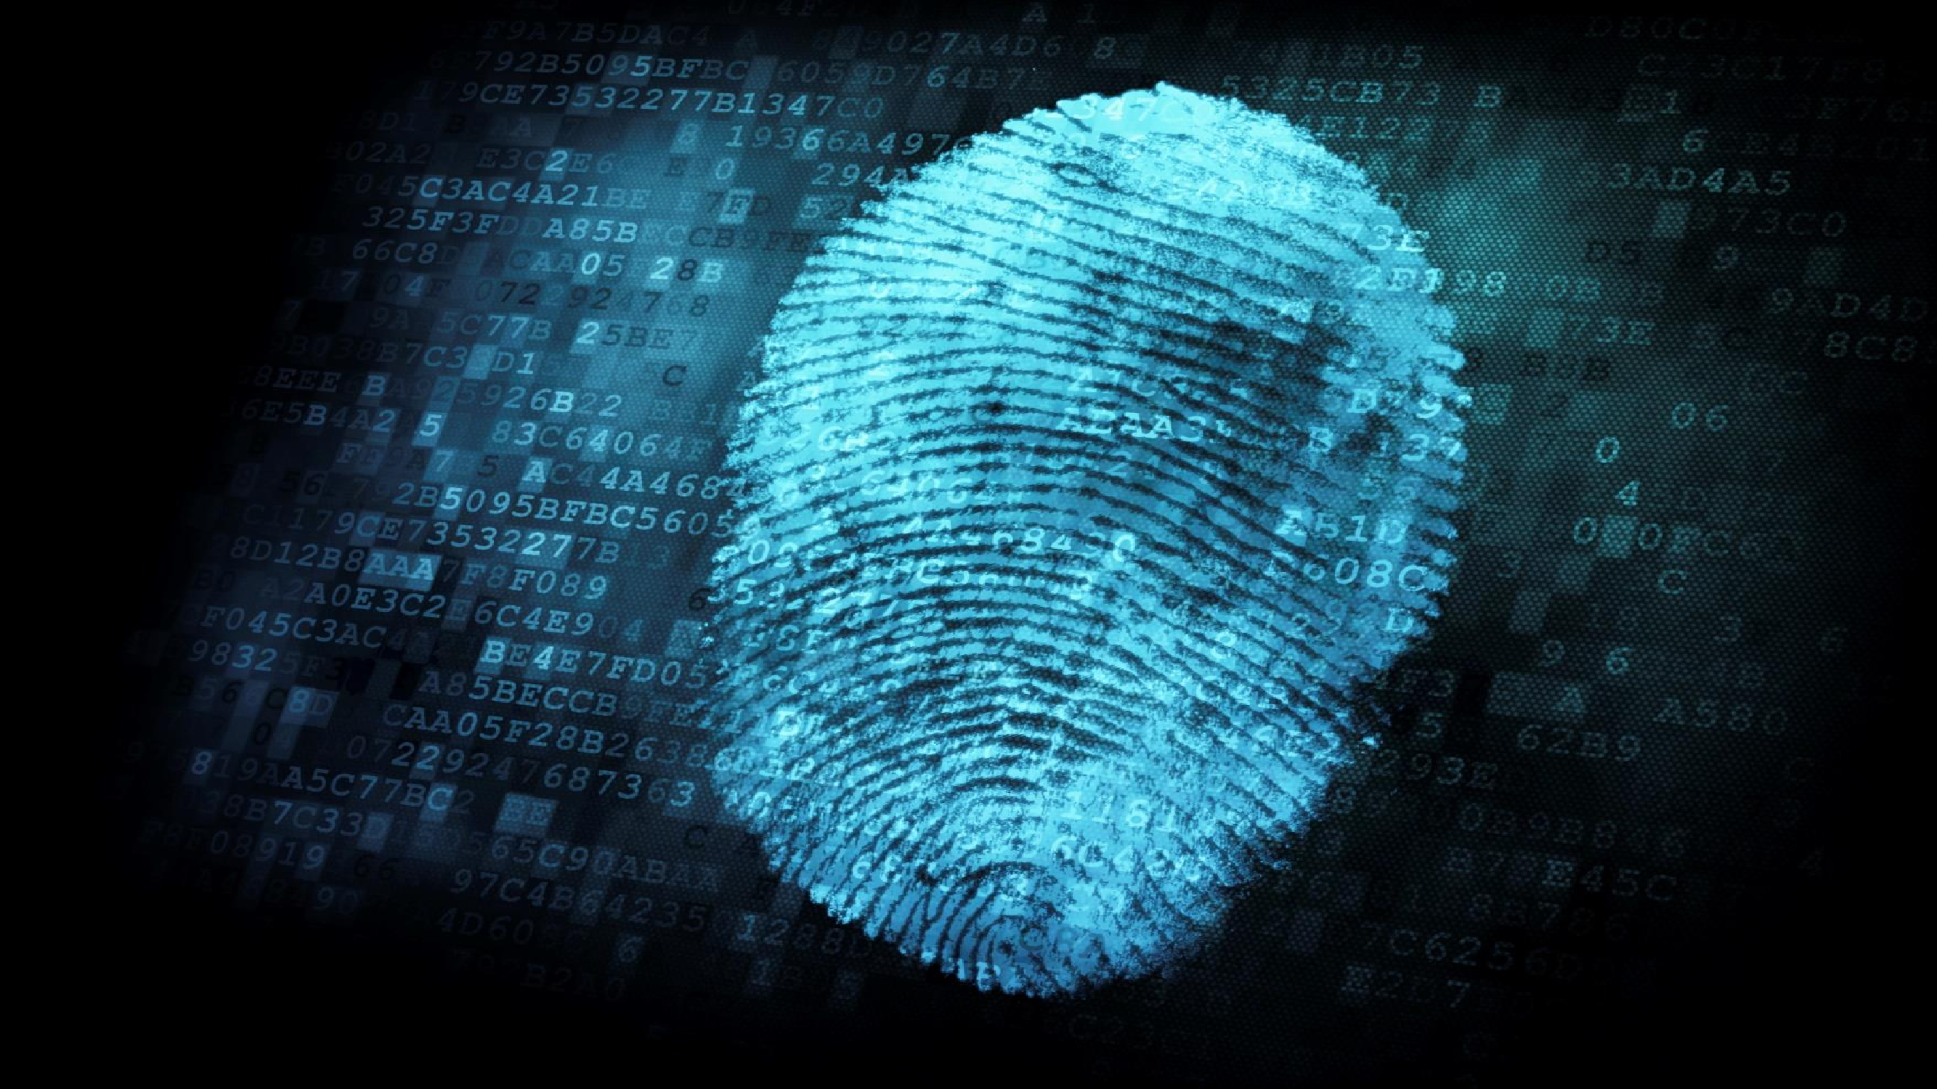
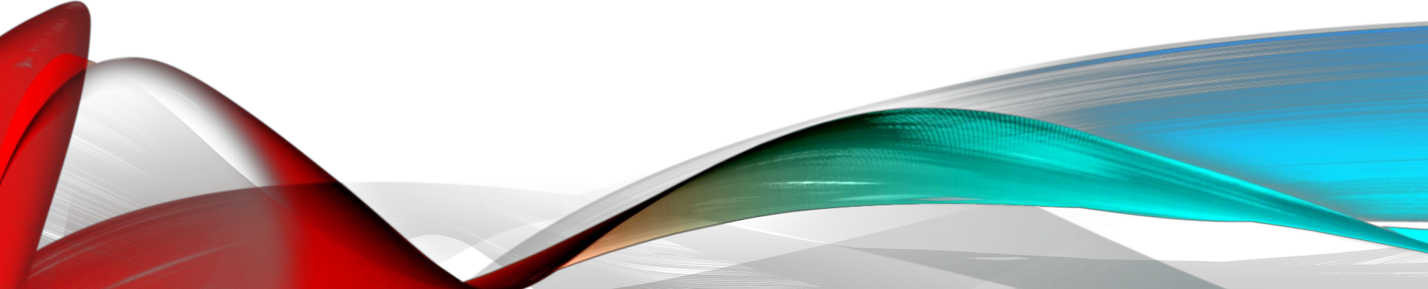
ANTI RIGGING VOTING MACHINE FOR FREE GOVERNING USING FINGER PRINT SENSOR
GUIDED BY:-
PRESENTED BY:-
A.VINEETH – 2014/B/03
R.MANIKANTA – 2014/B/33
N.JAI SAI GOUTHAM – 2014/B/25
Mr. T.SUNIL KUMAR

Slide 2
AGENDA
Introduction
Finger print voting machine
Block diagram
Components description
Circuit and flowchart
Software's used
Advantages and limitations
Future scope
Conclusion

Slide 3
INTRODUCTION
This project is designed for electronic voting machine by using the fingerprint identification method.
Here voter’s thumb impressions are used for identification.
During voting when the voter places his/her thumb on the scanner, the system will check
whether it matches with pre stored impressions in the database.
If it matches then system will allow the voter to poll his vote and otherwise prevent the voter from polling.

Slide 4
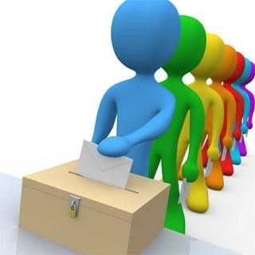
WHAT IS MEANT BY VOTING?
The objective of voting is to allow voters to exercise their right to express their choices regarding specific issues.
In a democracy, a government is chosen by voting in an election, a way for an electorate to elect, i.e. choose, among several candidates for rule.

Slide 5
TOOLS IMPLEMENTED FOR
VOTING.
Technology is being used more and more as a tool to assist voters to cast their votes.
The two types of systems implemented for voting are:
Ballot box.
Electronic Voting Machine(EVM).

Slide 6
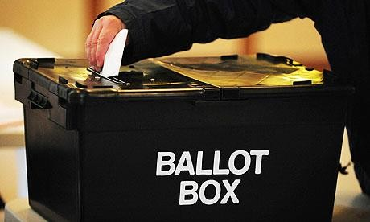
BALLOT BOX
First ballot box was held in Pontefract on 15 August 1872.
A ballot box is a temporarily sealed container, usually square box with a narrow slot in the top sufficient to accept a ballot paper in an election.

Slide 7
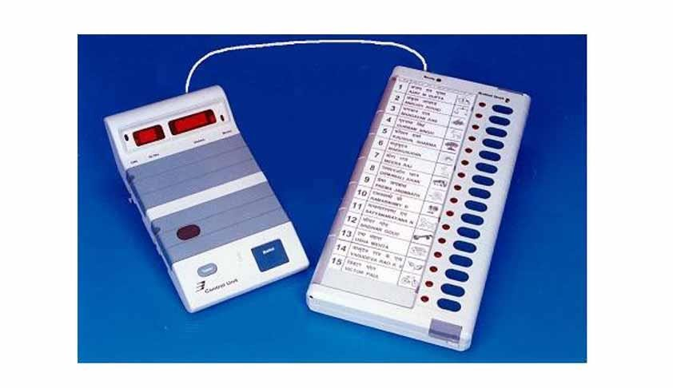
ELECTRONIC VOTING MACHINE(EVM)
EVMs were first used in the by-election to north paravur assembly constituency of kerala in 1981.
EVM consists of two parts:
Balloting unit and Controlling unit.
EVM reduce the time in both casting and declaring of results compared to ballot box.

Slide 8
ADVANTAGES OF EVM
Ballot box systems are prone to human errors and lot of time consuming.
EVM is human error free and time saver.
Provide multiple languages to users who may not have English as a first language.
EVM can provide headphones to read off instructions to the blind user.

Slide 9
DISADVANTAGES OF EVM
EVM are no different than websites or software; they can be penetrated and altered by a hacker.
Overall cost is high, physical tampering could be possible.
Computer software and systems can have problems that may delay or even halt voting.

Slide 10
FINGER PRINT VOTING MACHINE
Knowing the disadvantages in the previous methods the biometric method of voting is being implemented i.e., finger print based voting machine.
Here the voter has no need to carry his ID which contains entire details.
Instead the person has to show his finger at the polling booth
The finger print reader reads the details from the finger print and passed to corresponding controller.
If the data matches with the already stored information, the person is allowed to vote.

Slide 11
ADVANTAGES OF USING FINGERPRINT AS ID
Prevents unauthorized use or access.
Adds a higher level of security to an identification process
Eliminates the burden and bulk of carrying id cards or remembering pins.
Heightens overall confidence of business processes dependent on personal identification.

Slide 12
COMPONENTS
The FPBVM uses the following components:-
Microcontroller-AT89C52
Fingerprint module-R305
EEPROM(24C08A)
LCD display.
Keypad
Resistors
Capacitors
Crystal oscillator

Slide 13
MICRO CONTROLLER-AT89C52
One of the major differences between a microprocessor and microcontroller is that a controller deals with bits not bytes in the real world application.
Microcontroller has in-built memory whereas microprocessor has to go for external memory such as RAM,ROM,EPROM.
Development of a microcontroller reduces PCB size and cost of design.

Slide 14
FEATURES OF AT89C52
The AT89C52 is a low-power, high-performance CMOS 8-bit microcontroller.
Flash memory of 8KB.
Endurance-10,000 write/erase cycles.
4V to 5.5V operating range
Fully static operation: 0Hz to 33MHz
256x8 bit internal RAM
32 programmable I/O lines
Three 16-bit timer/counters
Eight interrupt sources
Full duplex UART serial channel
Low power idle and power-down modes
Fast programming time

Slide 15
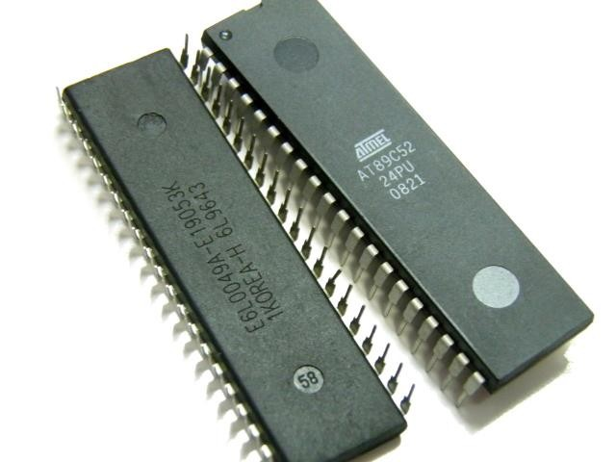
AT89C52

Slide 16
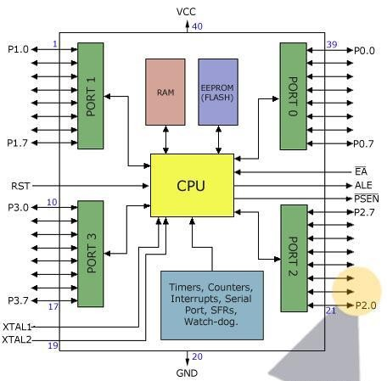
BLOCK AND PIN DIAGRAM

Slide 17
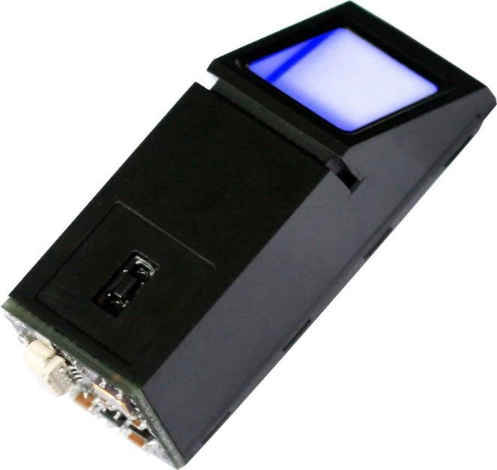
FINGER PRINT MODULE-R305
The fingerprint scanner used here is NITGEN company based which is the leading manufacturer of FIM(Finger identification Module)
The methodology involves of storing the fingerprint images as database and during voting the input image is matched using the database

Slide 18
FEATURES
Integrated image collecting and algorithm chip together
Low power consumption, low cost, small size, excellent performance
Professional optical technology, precise module manufacturing techniques
Good image processing capabilities, can capture up to resolution 500 dpi(dots per inch).

Slide 19
SPECIFICATIONS
Fingerprint sensor type: optical
Interface: USB 1.1/UART(TTL logical level)
Image capture surface 15-18(mm)
Verification speed: 0.3 sec
Scanning speed: 0.5 sec
Character file size: 256 bytes
Template size: 512 bytes
False acceptance rate:0.0001%
False rejection rate:0.1%
Matching method:1:N
Temperature:- 20 to 45 c

Slide 20
TECHNIQUES INVOLVED
The techniques used here are:
Extraction algorithm
Matching algorithm

Slide 21
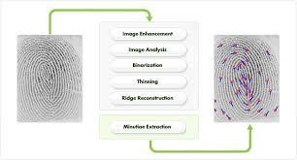
EXTRACTION ALGORITHM
Extraction algorithm involves:
Image enhancement
Image analysis
Thinning
Ridge reconstruction
Minutiae extraction

Slide 22
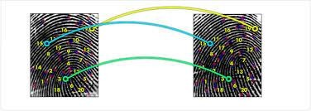
MATCHING ALGORITHM
The matching algorithm finds out whether there is a match by comparing two templates extracted by the characteristic point extraction algorithm, specially by comparing the positions of each characteristics point and the structure.

Slide 23
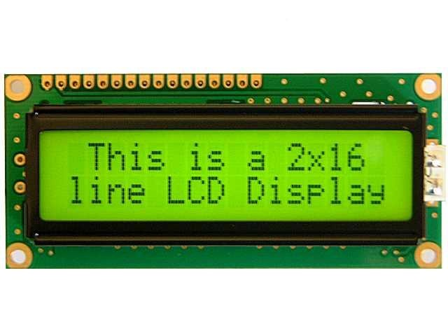
LIQUID CRYSTAL DISPLAY(LCD)
The LCD display is used to display the messages during the action.
Here a 16x2 display is used, each character is made of 5x7 dot matrix.
Displays have built in backlight(blue or green diodes)

Slide 24
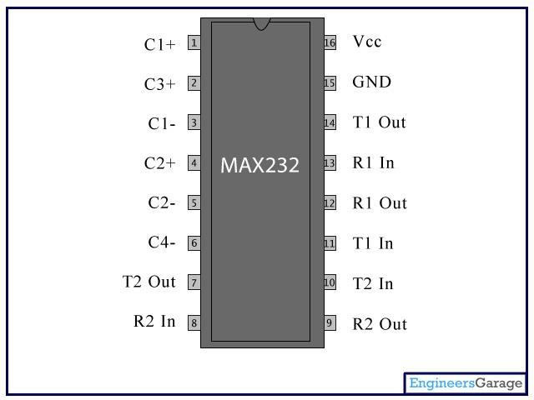
PIN DIAGRAM

Slide 25
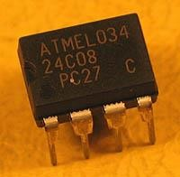
EEPROM
EEPROM- Electrically Erasable Programmed Read Only Memory.
It is a type of non-volatile memory used in computers and other electronic devices to store small amounts of data that must be saved when power is removed.
EEPROM can be independently read, erased and re-written.
We used 24C08A EEPROM.

Slide 26
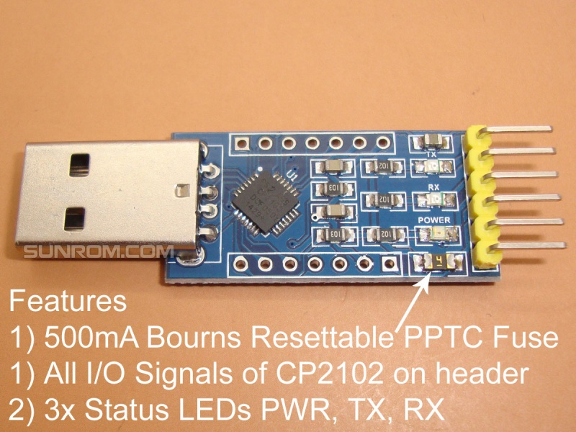
TTL UART
This module creates a virtual COM port using USB on your computer which can support various standard Baud Rates for serial communication.

Slide 27
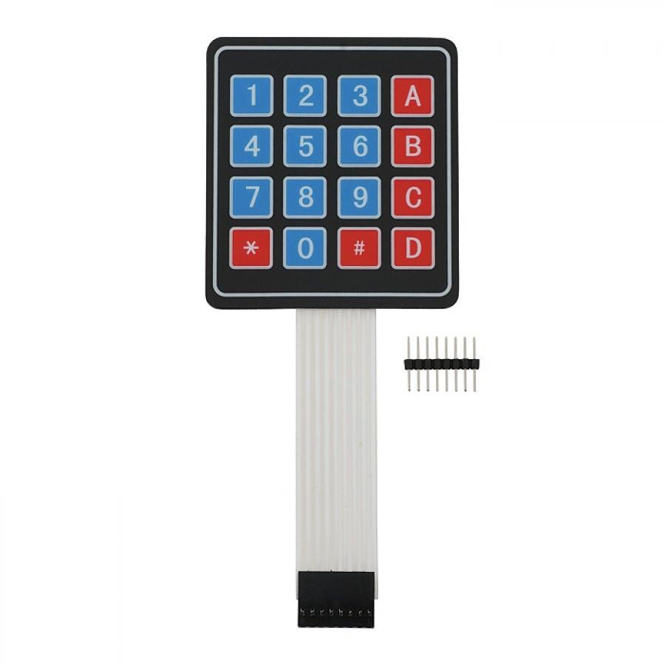
KEYPAD
The keypad allows the voter to poll his vote by selecting a party of his choice from the options provided.
There are 8pins, each pin corresponding to a row or column of the keypad.

Slide 28
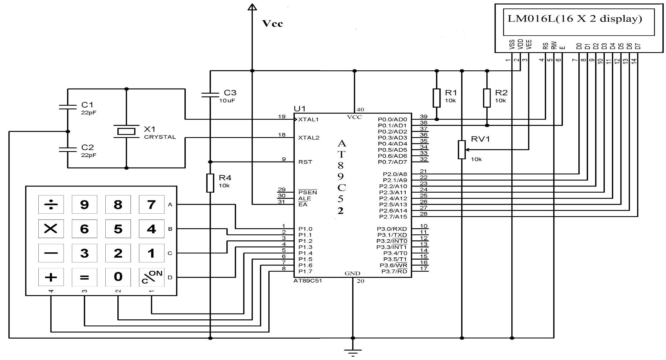
CIRCUIT DIAGRAM

Slide 29
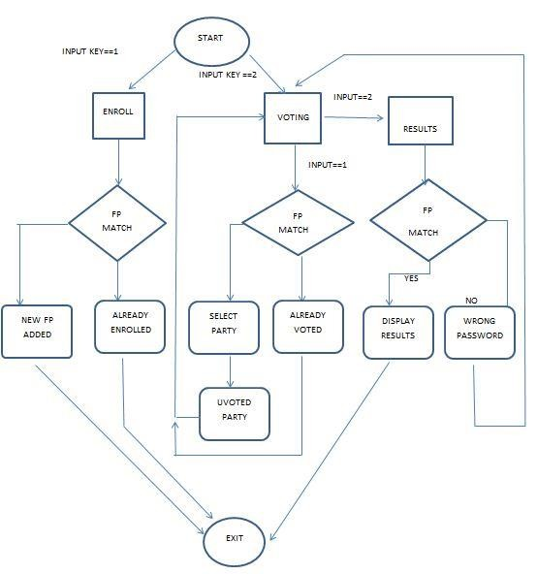
FLOW CHART

Slide 30
SOFTWARE'S USED..
The software's used in our project are:
Keil µ vision 3
Proteus

Slide 31
ABOUT KEIL..
The µvision3 is a windows based software development platform that combines a robust editor, project manager and makes facility.
µvision3 integrates all tools including the C complier, macro assembler, linker/locator and HEX file generator.
The vision3 user interface consists of menus, toolbar buttons, keyboard shortcuts,
dialog boxes and windows for managing various aspects of our project.

Slide 32
USING KEIL
The following are the steps involved in creating a HEX file:
create a new project from: project → new → µvision project.
choose your device(ex: AT89C52)
now make a new empty file (file → new) where you will type in the source code.
add all the required files to the source group
build target and generate the hex file.

Slide 33
PROTEUS
Proteus is a software for microprocessor simulation, schematic capture, and printed circuit board(PCB) design.
Proteus PCB design combines the ISIS schematic captures and ARES PCB layout programs to provide a powerful, integrated and easy to use suite of tools for professional PCB design.

Slide 34
PROGRAMMING
The source code is written in embedded C language.
The major reasons for writing programs in c instead of assembly:
It is easier and less time consuming to write in C than assembly.
C is easier to modify and update.
C code is portable to other microcontrollers with little or no modifications.

Slide 35
ADVANTAGES
Cost effective
Low power consumption
It is economical
Less manpower required
Time conscious, as less time required for voting and counting
Avoids invalid voting.
Saves transportation cost due to its compact size.
Convenient on the part of voter.

Slide 36
LIMITATIONS
The limitations of this projects are:
The collection of fingerprints of all the voters is little difficult.
Only fingerprints of the voters is identified instead of identifying the persons

Slide 37
FUTURE SCOPE
Number of candidates could be increased.
It could be interfaced with printer to get the hard copy of the result almost instantly
from the machine itself.
Once the result is on the server it could be relayed on the network to various offices of the election conducting authority.

Slide 38
CONCLUSION
This project can be used for voting since it overcome all the draw backs of ordinary voting machine.
It provide additional security.
Its main advantage is that since fingerprints of every person is unique and hence this system completely reduces the chance of invalid votes.
The system can be manufactured simply as well as cheap.

Slide 39
Thank you
Queries if any……

